Slide 1
Adaptive UI
Developer's guide to Windows 10 insider preview
Andy & Jerry

Slide 2
The adaptive story
Adaptive tooling

Slide 3
The adaptive story

Slide 4
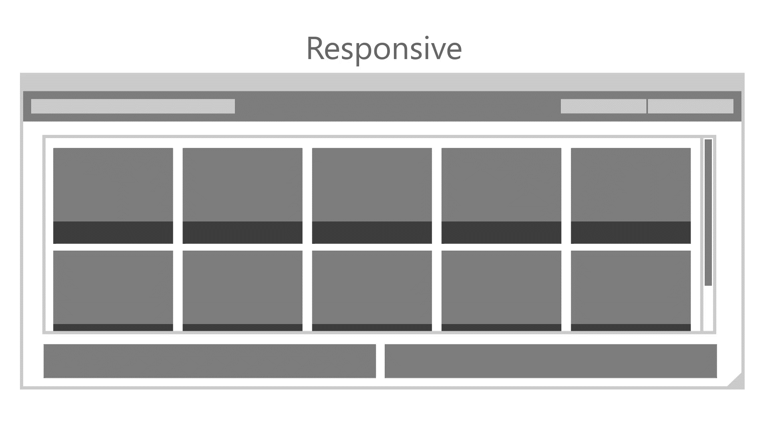

Slide 5
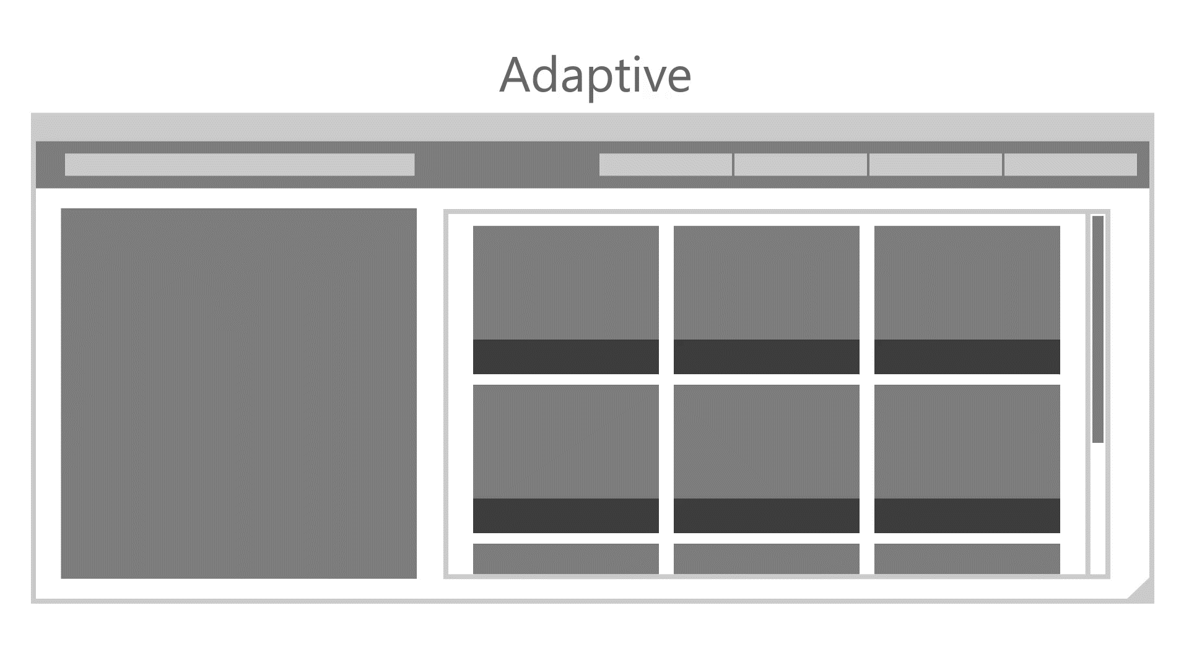

Slide 6
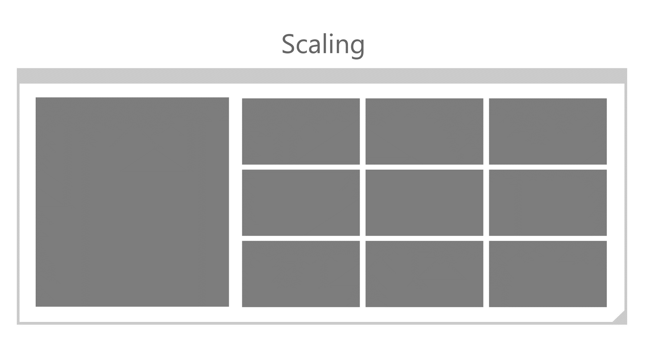

Slide 7
Tailored design
Build pages/code for individual families
Use MRT in App.xaml.cs to determine the family
One-handed interface?
Typically phone or small tablets
Test diagonal screen size (<7")
if (physical_diagonal_size <= 7)
// optimized for one-handed operation
rootFrame.Navigate(typeof(MainPage_OneHanded), e.Arguments);
else
rootFrame.Navigate(typeof(MainPage), e.Arguments);

Slide 8
Nothing is stopping you from creating a multi-headed solution

Slide 9
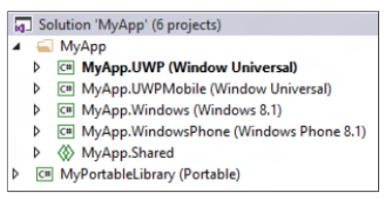
Dedicated, targeted apps

Slide 10
Adaptive tooling

Slide 11
Visual States
Define XAML views
Unique layout for distinct states
Simplify animation
Automatically implement state transitions
Build in Blend
Design and preview states and transitions

Slide 12
Visual states

Slide 13
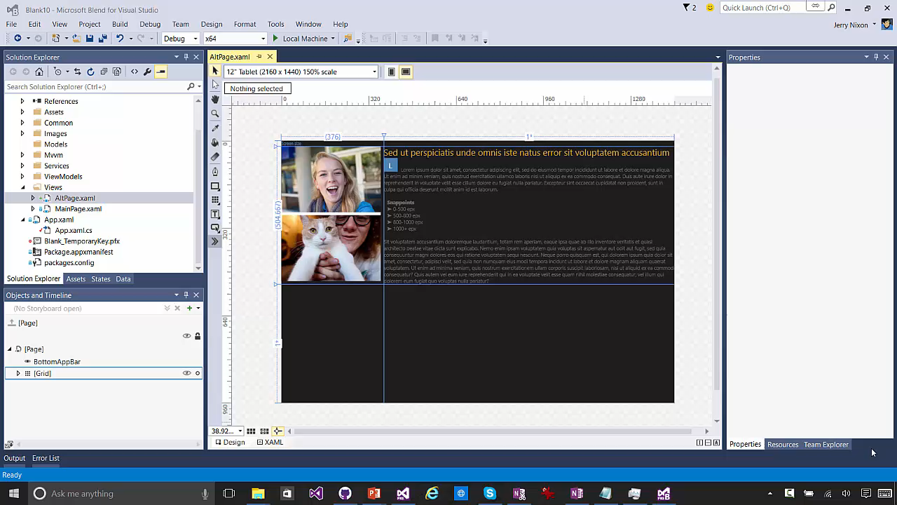

Slide 14
Visual states let designers define many looks of a view

Slide 15
How to set the visual state
VisualStateManager.Goto(element, state, transition)
public MainPage()
{
this.InitializeComponent();
this.SizeChanged += (s, e) =>
{
var state = "VisualState000min";
if (e.NewSize.Width > 500)
state = "VisualState500min";
else if (e.NewSize.Width > 800)
state = "VisualState800min";
else if (e.NewSize.Width > 1000)
state = "VisualState1000min";
VisualStateManager.GoToState(this, state, true);
};
}

Slide 16
Adaptive triggers

Slide 17
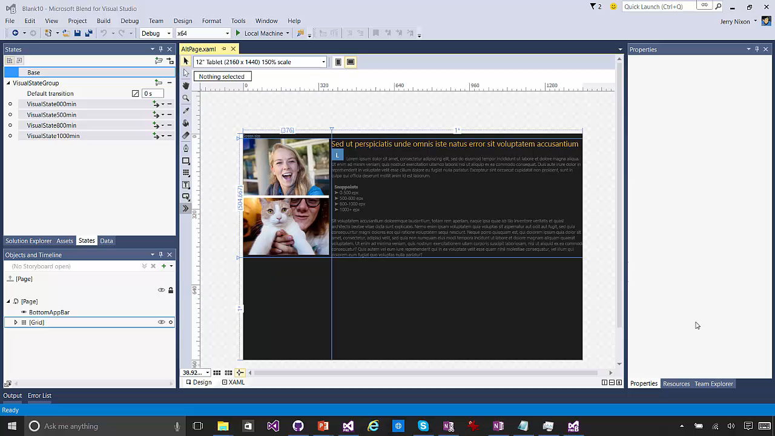

Slide 18
Adaptive triggers are a zero-code solution

Slide 19
Adaptive triggers
Code-free state transition
Two built-in triggers
MinWindowHeight (Taller than this)
MinWindowWidth (Wider than this)
<VisualState x:Name="VisualState500min">
<VisualState.StateTriggers>
<AdaptiveTrigger MinWindowWidth="501" />
</VisualState.StateTriggers>
</VisualState>

Slide 20
Custom triggers

Slide 21
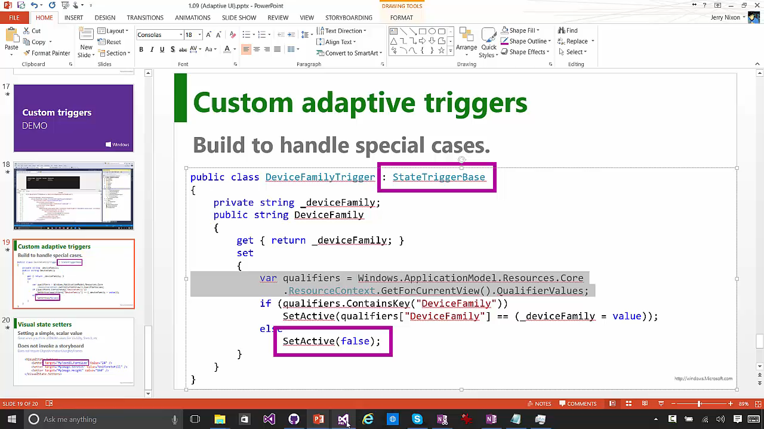

Slide 22
Custom triggers support your special scenarios

Slide 23
Custom adaptive triggers
Build to handle special cases.
public class DeviceFamilyTrigger : StateTriggerBase
{
private string _deviceFamily;
public string DeviceFamily
{
get { return _deviceFamily; }
set
{
var qualifiers = Windows.ApplicationModel.Resources.Core
.ResourceContext.GetForCurrentView().QualifierValues;
if (qualifiers.ContainsKey("DeviceFamily"))
SetActive(qualifiers["DeviceFamily"] == (_deviceFamily = value));
else
SetActive(false);
}
}
}

Slide 24
Visual state setters
Setting a simple, scalar value
Great when you think of ENUM values like Visibility, Stretch, etc
Does not invoke a storyboard
Does not require ObjectAnimationUsingKeyFrames
<VisualState.Setters>
<Setter Target="MyText01.FontSize" Value="24" />
<Setter Target="MyImage.Stretch" Value="UniformToFill" />
<Setter Target="MyImage.Height" Value="150" />
</VisualState.Setters>

Slide 25
XAML's RelativePanel control
A child or two act as a anchor elements
They are relative to the panel
Other children are relative to the anchors
RelativePanel.Above = "ElementName"
RelativePanel.RightOf = "ElementName"
RelativePanel.Below = "ElementName"
RelativePanel.LeftOf = "ElementName"
RelativePanel simplifies adaptive UI
A simple Visual State setter can rearrange the UI
One element can move a family of related elements

Slide 26
Developers have many tools build an adaptive UI

Slide 27
The adaptive story
Adaptive tooling

